Slide 1
Sarcasm Detection in Plain Text using Deep Learning with Tensorflow
Sanjay Khatwani
Savitha Jayasankar
Saurabh Parekh

Slide 2
What is Sarcasm?
“When I see ads on TV with smiling, happy housewives using a new cleaning product, the only thing I want to buy are the drugs they must be on”
That’s Sarcasm: Use of words that mean something other than what you want to say, to insult someone, show irritation, or simply be funny.
Notes:
(As if we are the only one’s who know what it is) Sarcasm is an ironic or satirical remark that seems to be praising someone or something but is really taunting or cutting. Sarcasm can be used to hurt or offend or can be used for comic affect

Slide 3
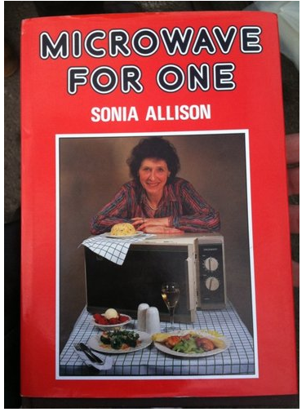
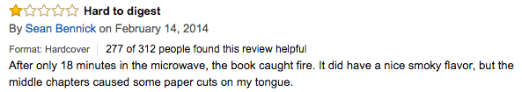
Applications of the Project
Identifying irrelevant and sarcastic comments and reviews for effective business decisions.
Notes:
Talk about Amazon’s product reviews, So where can we use this application ?... for data preprocessing. We need to identify the Sarcasm because sarcastic statements are generally opposite idea of what the user wants to convey so considering these statement relevant and using it for making business decisions can lead to unfavorable outcome.

Slide 4
Why is it so difficult to detect sarcasm in plain text?
In several instances, sarcasm is due to the presence of:
Body language
Intonation
Context
Personality Traits
These are absent in plain text
Notes:
“Yeah right” Its easy to identify sarcasm when you are talking to some one because of their tone and expression but in text all these attributes are absent making it difficult to identify if the statements are sarcasm or not.

Slide 5
Our Inspiration
thesarcasmdetector.com
Uses Naïve Bayes and SVM models
trained using tweets to predict sarcasm score for a sentence.
Let’s check it out!
Notes:
Going to the gym surely makes you fit, in a same way standing in a garage make you a car!
Create a textfile to get input sentences.

Slide 6
Digging into the Inspiration
Extracts multiple features:
N-grams
Polarity and subjectivity
Topic
Different combinations of the above features are used for training the model.
Average F1-score of 0.56
Notes:
Talk about each feature
Talk about f1 measure .why not accuracy for this project?
N- grams it breaks the sentence in n contiguous statements of n items or n sentences.
Polarity - How positive or negative the statement is.
Subjectivity- it’s the score how subjective or objective the sentence is We cannot use accuracy because of our nature of data set hence we have used F1 score.

Slide 7
Enough about other project, tell us about yours….
Trained Deep Learning model using the same dataset to detect sarcasm.
Using Google’s deep learning library Tensorflow.
Extracted one feature from the sentence:
Polarity and subjectivity
Generally sarcastic sentences or dialogues posses huge contrast of sentiments. That’s the characteristic that exploited and trained in the model.
Notes:
So we take that project a step further and implement a deep learning model for the same purpose and using the same data set.
Using Google’s deep learning library Tensorflow.
Extracting just one type of feature from the sentence:
Polarity and subjectivity
Generally sarcastic sentences or dialogues posses huge contrast of sentiments. That’s the characteristic that we exploit and train our model.

Slide 8
Tensorflow
Popular library for Deep Neural Networks.
Widely used because of it’s efficiency and ease of use.
Tensors = Multidimensional arrays
Allows you to define data flow graphs using tensors.
Provides superior performance
Provides auto-differentiation, very useful for gradient based models.
Builds sophisticated visualizations using TensorBoard
Notes:
In auto differentiation systems basically when you define an operator (op), you also define together how its derivatives are computed (of course most of the common ops are already provided).
So after you write a function by stacking a series of ops, the program can figure out by itself how should the corresponding derivatives be computed (usually by keeping some computation graphs and using the chain rule).
The benefit is obvious as it saves us from working out the math, writing the code, verifying the derivatives numerically...
Superior performance = Runs different from python avoiding it’s disadvantages.

Slide 9
Start with the project already!
Feature Extraction
Tokenize and preprocess.
Used TextBlob to extract polarity and subjectivity of sentence and it’s parts
Full sentence, half sentences, thirds and fourths.
23 features per sentence
Need minimum of 4 words in a sentence to detect sarcasm.
Notes:
Tokenize using nltk
Convert to lower case
Extract features
23 from on sentence.

Slide 10
What do the features mean?
TextBlob used for part-of-speech tagging, noun phrase extraction, sentiment analysis etc.
Polarity = positivity (-1 to 1), subjectivity (0 to 1, 0 = objective, 1 = subjective).
Polarity of whole sentence, polarities of two parts of sentence, three and four
Helps to assess the change in sentiments throughout the sentence when it is divided into parts
Notes:
Getting polarities using TextBlob
Polarity of full sentence and parts after dividing it into 2 3 and 3 equal parts
Helps find the range of polarities through the sentence and contrast
Contrast from one part to the other
Contrasting sentence = sarcasm

Slide 11
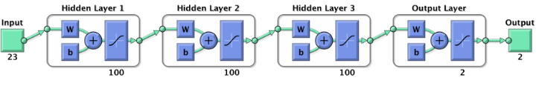
Building The Model
Layers-3 hidden layers.
No of neurons in each layer-100
Fully connected neural network
Output layer- 2 classes
One Hot encoding
Notes:
3 hidden layers
100 neurons in each hidden layer
2 neurons in output layer
Why not 1 for binary classification – one hot encoding.
One hot encoding works better with classification and regression models because it builds a balanced matrix that’s easy to work with in complex computations.

Slide 12
Layers in Focus
How to define each layers:
hidden_layer = {'f_fum': n_nodes_hl,
'weight': tf.Variable(
tf.random_normal([len(train_x[0]), n_nodes_hl])),
'bias': tf.Variable(tf.random_normal([n_nodes_hl]))}
How to compute output of the layer:
output layer= tf.add(tf.matmul(data, hidden layer['weight']), hidden layer['bias'])
output layer= tf.nn.relu(output layer)
How to compute output of the output layer:
output = tf.matmul(output layer2, output layer['weight']) + output layer['bias']
Notes:
Dictionary with layer properties
Number of neurons, array of weights and bias
Output = input * weight + bias
This value is passed through activation function.
Relu(Rectified Linear Unit): Activation function. Decides if neuron will fire or no.
It was found to greatly accelerate the convergence of stochastic gradient descent compared to the sigmoid/tanh functions. It is argued that this is due to its linear, non-saturating form.
The softmax with logits function measures the probability error between the actual and the expected output and then squishes it such that sum of all elements is 1. Then cross entropy
is used to calculate the error because it is proven to give a better measure of accuracy as opposed to the crude classication error.
Then the mean of the output of the softmax function is calculated. This value gives the mean cost of the epoch.
The way to achieve the goal is also defined which is stochastic gradient descent.
The Adam optimizer is used for this because it provides faster convergence. Asidefrom that it also chooses a separate learning rate for each attribute.
Finally the optimizer and cost are tied together and the neural network is run.
, c = sess.run([optimizer, cost], feed dict=x: batch x, y: batch

Slide 13
Running the Network
Fetching the Prediction:
Run the model as follows:neural network model(x)
Backpropagation:
cost = tf.reduce mean( tf.nn.softmax cross entropy with logits(logits=prediction, labels=y))
Optimizer:
optimizer = tf.train.AdamOptimizer().minimize(cost)
Run the Dataflow Graph:
_, c = sess.run([optimizer, cost], feed dict=x: batch x, y: batch y)
Notes:
The softmax with logits function measures the probability error between the actual and the
expected output and then squishes it such that sum of all elements is 1. Then cross entropy
is used to calculate the error because it is proven to give a better measure of accuracy
as opposed to the crude classication error. Then the mean of the output of the softmax
function is calculated. This value gives the mean cost of the epoch.
The way to achieve the goal is also dened which is stochastic gradient
descent. The Adam optimizer is used for this because it provides faster convergence. Aside
from that it also chooses a separate learning rate for each attribute. Finally the optimizer
and cost are tied together and the neural network is run.
, c = sess.run([optimizer, cost], feed dict=x: batch x, y: batch

Slide 14
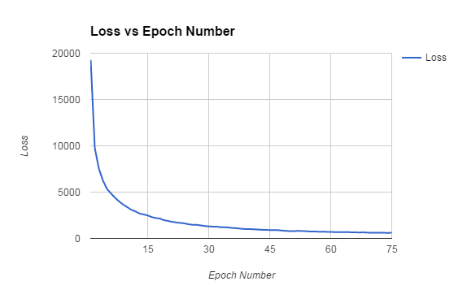
Training the Model

Slide 15
Testing the Model
predicted_output= tf.argmax(prediction, 1)
predicted_value_y= sess.run([accuracy, predicted_output],
feed_dict={x: test_x,
y: test_y})
predicted_value_x= np.argmax(test_y, 1)
Notes:
Define the operator to get predicted output
Run this operator on testing set to get predictions
Get actual values and compare the both to calculate the

Slide 16
F1-measure
Value ranges between 0 and 1.
f1_score(prediction_value_x, prediction_value_y)
F-measure = 2 * ((precision * recall) / (precision + recall))
Precision:
precision=true positives / ( true positives + false positives
Recall:
recall=true positives / (true positives + false negatives)
Notes:
F1 score
Amount of regular to irregular count. 83% for regular .
We cant use f1 score due to the material of dataset.
The F1 score or F-measure is a number between zero and one which determines how the
neural network works during the testing phase.
F-measure = 2 * ((precision * recall) / (precision + recall))
Precision is the what percentage of sentences that the classier labeled as sarcastic are actually
sarcastic. precision=true positives / ( true positives + false positives
Recall is the what percentage of sarcastic sentences did the classier label as sarcastic.
recall=true positives / (true positives + false negatives)

Slide 17
Visualization of Model
Tensorboard:
Operates by reading TensorFlow events files which contains summary data that you can generate when running TensorFlow
How to Collect Summary Data:
Change in Learning rate over time and how the objective function is changing is stored as scalar operators.
Add the parts of the dataflow graph as name_scope of the summary.
Merge operations into summary and create a log file.
Notes:
The computations you'll use TensorFlow for - like training a massive deep neural network - can be complex and confusing.
To make it easier to understand, debug, and optimize TensorFlow programs, we've included a suite of visualization tools called TensorBoard
You can use TensorBoard to visualize your TensorFlow graph, plot quantitative metrics about the execution of your graph, and show additional data like images that pass through it.

Slide 18
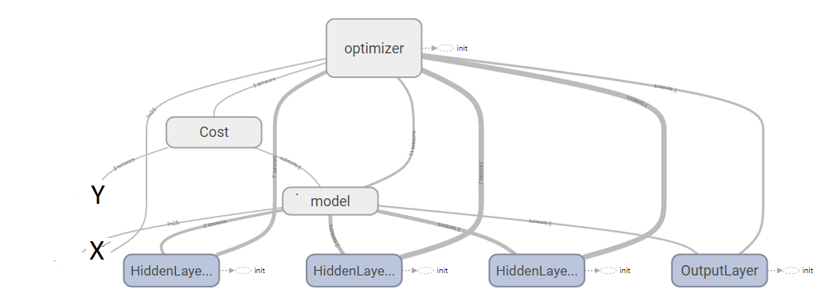
Tensorboard dataflow graph

Slide 19
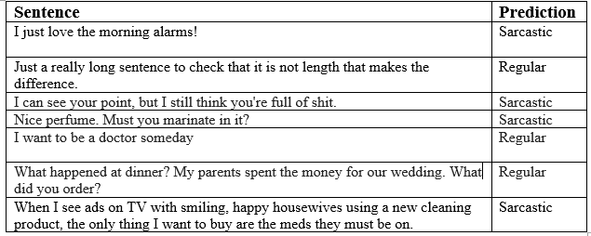
Experiment
Notes:
Talk about limitation
Min length of 4
2)Misclassification due to nature of the text.
4)Only one feature

Slide 20
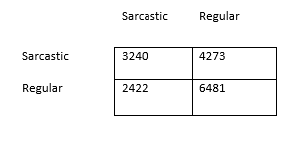
Result Analysis
Obtained F1- score =0.6 for one feature.
Confusion Matrix:
Notes:
From 16416 instances of sarcastic and regular sentences, the model was able to successfully
classify 3240 instances of sentences as sarcastic from total of 7513 sarcastic sentences. 6481 instances
of regular sentences were classied correctly from 8903.

Slide 21
Future Development
Include topic extraction of sentences in feature extraction
Obtain better classified data.
Train the model using more data

Slide 22

Q/A

Slide 23
Thankyou!!

